Slide 1
Government of Yukon Update
Fish and Wildlife Branch, Environment Yukon
Mike Suitor
North Slope & Migratory Caribou Biologist
May 11, 2021

Slide 2
Fish and Wildlife Branch - YG
Data rich for multiple wildlife species
Most work is management oriented but many collaborations
Work very closely with First Nations/Inuvialuit and other agencies
Number of recent and ongoing ABoVE collaborations:
  Environmental drivers of migration timing (Gurarie et al. 2019)
  Lichen cover mapping (Macander et al. 2020)
  Ecological insights three decades wildlife data (Davidson et al. 2000)
  Caribou response to fire (Palm et al. submitted)
  Summer foraging ecology Fortymile caribou (Ehlers et al. in preparation)
  Mapping above-ground biomass of tundra (Orndahl et al)
Co-supervision/committee members and internships commonly

Slide 3
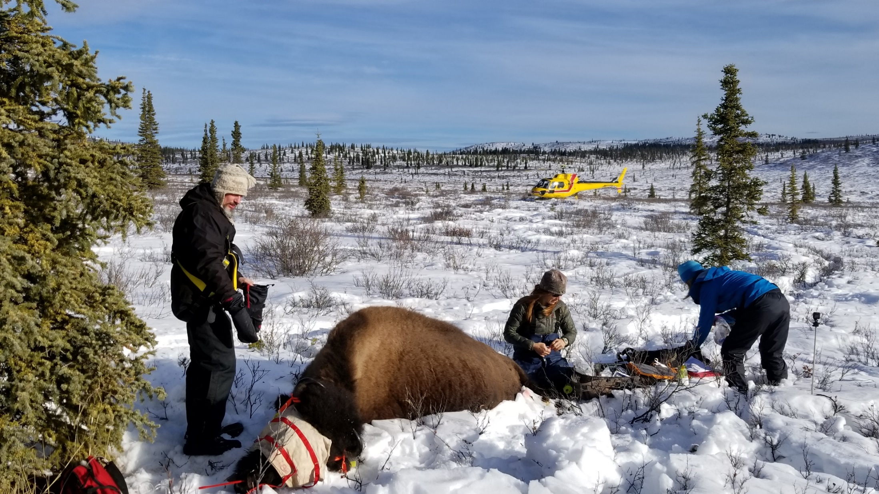
Wood Bison Research – Tom Jung
From 2005 to present:
  130 adult female bison with GPS collars (gap from 2012-2015)
  15 tracked >4 years (max = 7.3 years)
  Locations are either daily or (mostly) hourly

Slide 4
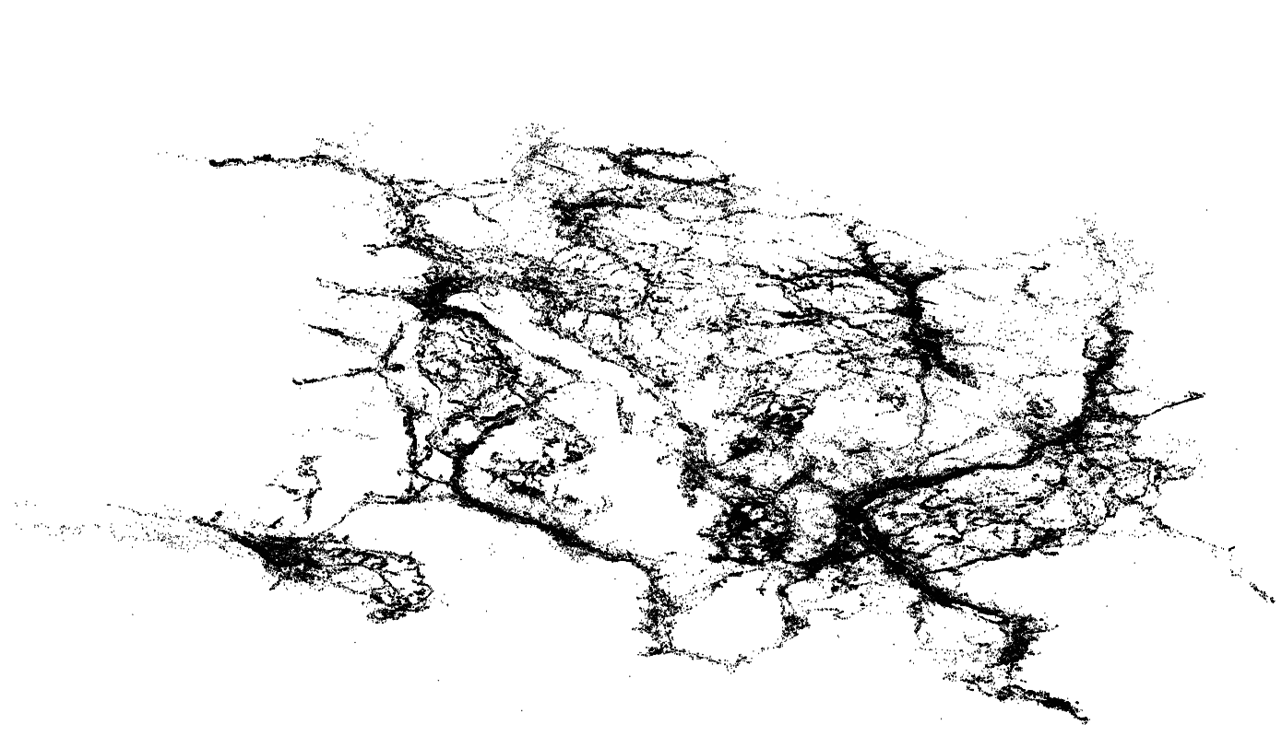
Dataset >600,000 locations and growing
Bison in this population are migratory (elevation) and use a ~9000 km2 area
Subpopulation structure exists, habitat is heterogeneous, and they are hunted in winter

Slide 5
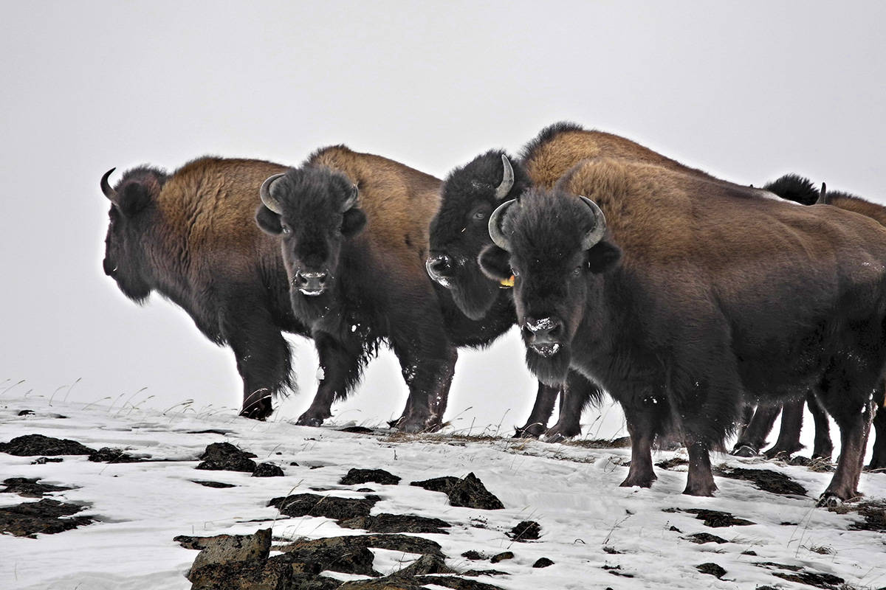
Bison GPS collar data and collaborating to multi-species movement and resource selection studies being done under ABoVE
Particular interest: wildlife responses to climate warming impacts such as snow depth and duration, fire, shrubification, and other landscape changes

Slide 6

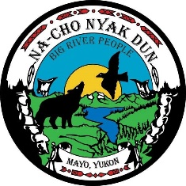


Northern Tutchone Camera Trapping Project
Objectives – Megan Hornseth
Collect current information on the distribution and abundance of grizzly bears, moose, and other large mammals within the Beaver River Planning Area and the Mayo Moose Management Unit.
Assess the impact of current disturbance levels on the distribution of grizzly bears, moose, and other large mammals to inform cumulative effects assessment

Slide 7
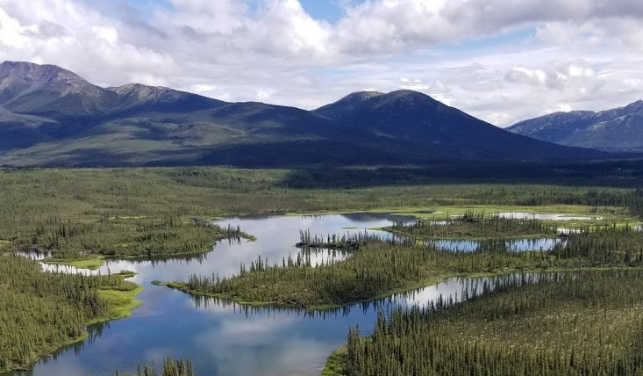
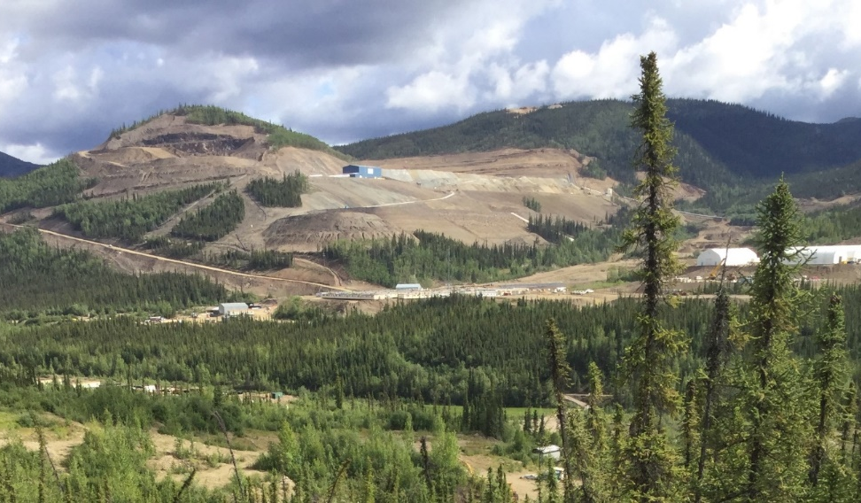
Cumulative Effects Remote Camera Study Design
Two landscapes – Beaver River & Mayo Moose Mgmt Unit
Stratification across a range of disturbance types
(linear features, fire, quartz & placer mining)

Slide 8
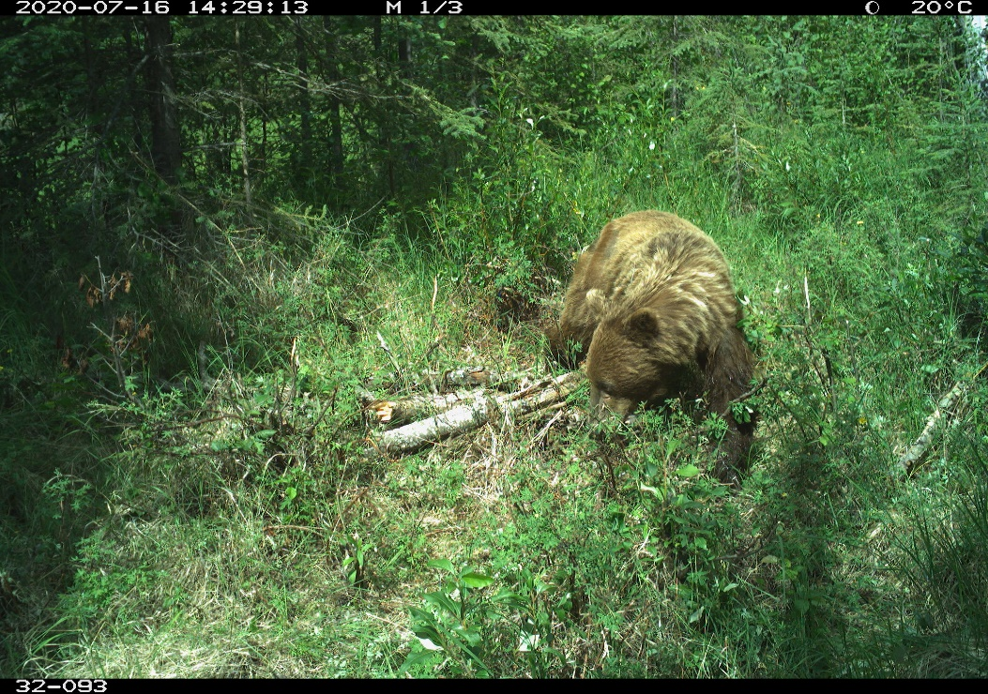
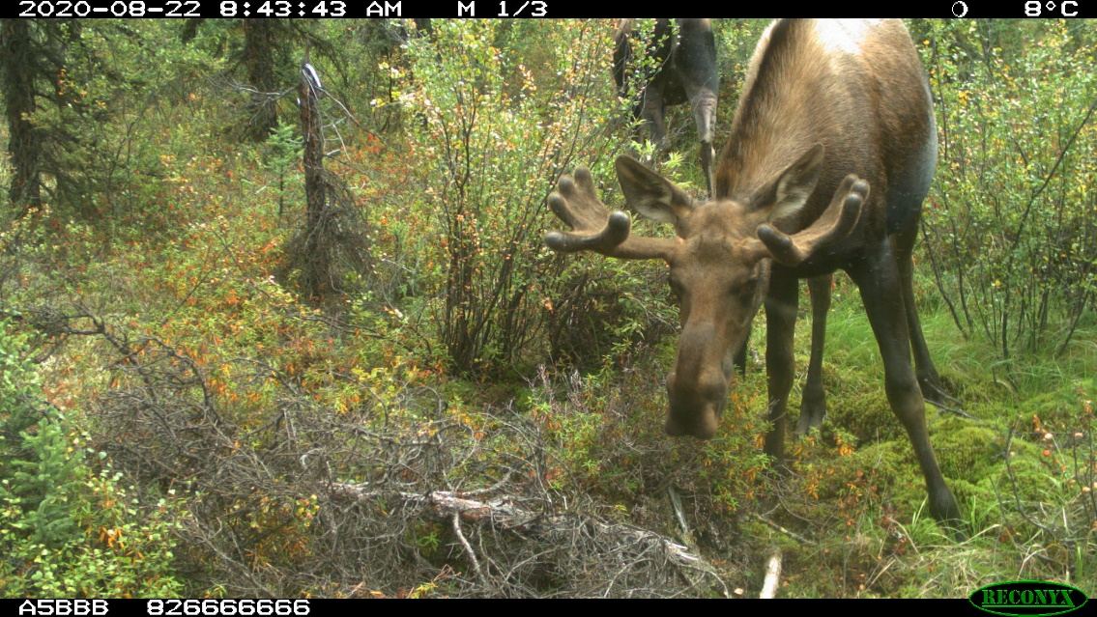
Potential Collaborations
Significant need for products useful for species, land management and planning
Interested in collaborating on CE and disturbance projects
  Focus on caribou, moose and grizzly bears
Disturbance layer is badly needed – work underway

Slide 9
Caribou
Substantial work on different ecotypes
Work on 2 large migratory (Porcupine/Fortymile), Boreal Woodland, and numerous Northern Mtn Woodland
  Management of harvest and land use
  Population monitoring and modelling
  Habitat needs and responses to development
  Collaborate on genetics research with numerous labs
  Health related monitoring
  Climate change and effects on herds is a significant question to all of the above

Slide 10
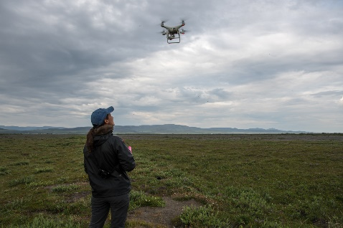
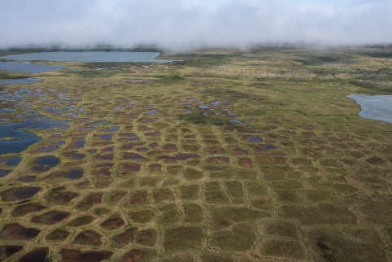
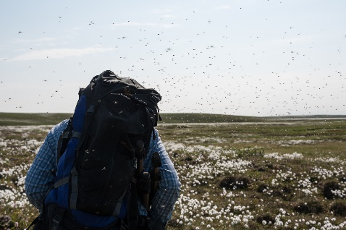
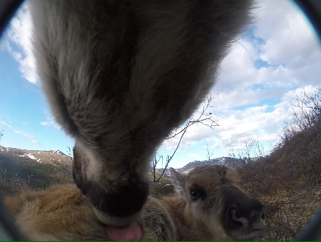
Potential Collaborations
Development of Ecological change and livelihoods in the Porcupine Caribou summer range
Focus on:
  Trophic shifts/changes on the summer range of the Porcupine herd
  Understanding impacts to the communities that rely on this area
  Facilitating greater community capacity and involvement
  Sharing and weaving of Indigenous and scientific knowledge

Slide 11
Potential Collaborations
Potential for numerous collaborations on Woodland caribou
Existing work by Eric Palm, others before that
Data rich:
  Currently 20-35 collars on numerous herds
  Historical and survey data to match
  Available through MoveBank through formal collaboration with us
Novel use of GPS Camera Collars
  Vast quantities of data to be managed and analyzed
  Just scratching the surface…
Habitat data has been and is being collected

Slide 12
Contacts
Mike Suitor, North Slope & Migratory Caribou Biologist, mike.suitor@yukon.ca – Caribou and land use/management in northern Yukon
Tom Jung, Senior Wildlife Biologist, tom.jung@yukon.ca – Bison and biodiversity
Megan Hornseth, Cumulative Effects Biologist, megan.hornseth@yukon.ca – Cumulative effects focus on bears, caribou, moose

